Slide 1
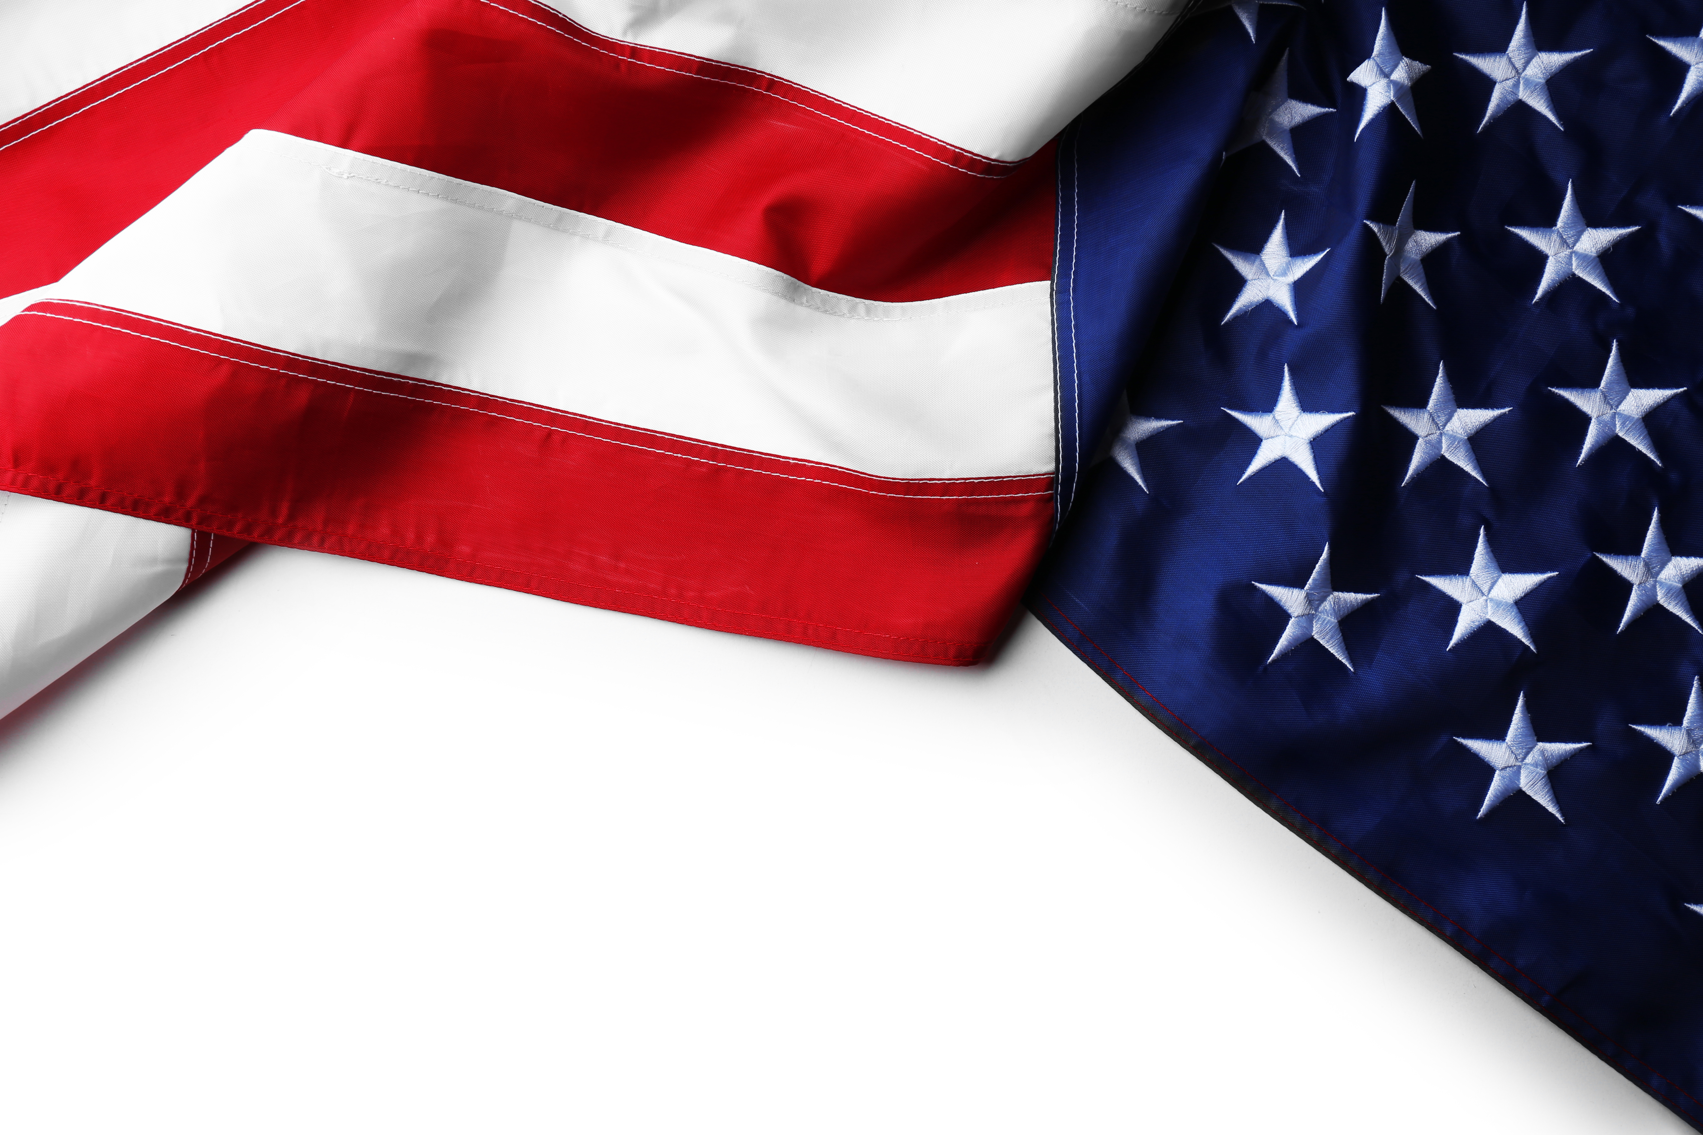
AN ACCG TRIBUTE HONORING THOSE WHO SERVED

Slide 2
Air Force
Joe Goodman, Barrow County
William Brown, Barrow County
Robert Brockman, Bleckley County
Robert Ott, Cobb County
David Barron, Dooly County
Harry Ward, Dooly County
Brian Croft, Evans County
Bill Brunson, Glynn County
Ernie Filice, Greene County
Terrell Reid, Hancock County

Slide 3
Air Force
John Scarborough, Madison County
Alfred McCoy, Meriwether County
Billy Webster, Putnam County
Scott Crane, Rabun County
Edward Burten, Washington County
Mel Powell, Wilcox County

Slide 4
Army
Dennis Williams, August-Richmond County
Sammie Sias, Augusta-Richmond County
John Thomas, Bacon County
Richard Foskey, Bacon County
Lee Hagans, Bacon County
Henry Craig, Baldwin County
Ben Hendrix, Barrow County
Billy Parks, Barrow County
Roy Thompson, Bulloch County
Charlie Williams, Calhoun County
Jim Cutler, Catoosa County
Alphya Benefield, Charlton County
Roger Metts, Clinch County

Slide 5
Army
Evelyn Woodson, Columbus-Muscogee County
Don Jernigan, Columbus-Muscogee County
Jerry Barnes, Columbus-Muscogee County
John House, Columbus-Muscogee County
Mike Riddle, Columbus-Muscogee County
Oscar Paulk, Coffee County
Dewey Galeas, Columbia County
Tommy Martin, Cusseta-Chattahoochee County

Slide 6
Army
Allan Bradford, Dade County
Stephen Bradshaw, DeKalb County
Lamar Hudgins, Dougherty County
Edge Gibbons, Fayette County
Dennis Brown, Forsyth County
Charles Glass, Lamar County
Marion Stevens, Liberty County
David Richardson, Long County
Michael Riddle, Long County
Bobby Mayfield, Lumpkin County
Jeff Moran, Lumpkin County

Slide 7
Army
Chris Dockery, Lumpkin County
Benjamin Haugabook, Macon County
Steve Young, Marion County
Norman Royal, Marion County
Sammie Wilson, McDuffie County
Benjamin Hayward, Mitchell County
Dewey Galeas, Mitchell County
Larry Evans, Monroe County
Donald Harris, Morgan County
Mark Saxon, Oconee County
David Clark, Oglethorpe County

Slide 8
Army
Kent Woerner, Rabun County
Bobby Kennedy, Tattnall County
Brent DuBois, Tattnall County
William Kicklighter, Tattnall County
Charlie Williams, Thomas County
Richard English, Troup County
James Maxwell, Washington County
Henry Mitchell III, Washington County
Alfonza Hall, Wilcox County
Michael Gotell, Wilkinson County

Slide 9
Army & Air Force
Sammie Wilson, McDuffie County

Slide 10
Army National Guard
Roy Thompson, Bulloch County
Horace Harper, Elbert County
Chris Dockery, Lumpkin County
Bobby Mayfield, Lumpkin County
Jeff Moran, Lumpkin County
Benjamin Haugabook, Macon County
Bobby Kennedy, Tattnall County
GW Thompson, Tattnall County
Wayne Tatum, Tattnall County
William J Kicklighter, Tattnall County
Franklin Wuinn Mullis, Treutlen County
Horace Daniel, Washington County

Slide 11
Georgia Air National Guard
Forrest Floyd, Effingham County

Slide 12
South Carolina
Army National Guard
Casey Freeman, Jr., Elbert County

Slide 13
Marine Corps
David Jones, Candler County
Mike Boyce, Cobb County
Paul Nagy, Colquitt County
Steve Rapson, Fayette County
David Carmichael, Paulding County
Jackie C. Trim, Tattnall County
Wiley Grady, Thomas County
Frank Simmons, Washington County
Terry Goodger, White County
John Williams, Wilkinson County

Slide 14
Marine Corps & Army
Demarcus Marshall, Lowndes County

Slide 15
Navy & Army
F. Culbertson, Candler County

Slide 16
Navy
Bennie Calloway, Ben Hill County
Lannie Brant, Camden County
Steve Fuller, Carroll County
Debra Thomas, Clinch County
Gerald Douglas, Cusseta-Chattahoochee County
Jim Lawrence, Cusseta-Chattahoochee County

Slide 17
Navy
Roger Burdette, Effingham County
J Peter Murphy, Glynn County
Tommy New, Jefferson County
Julius Hatcher, Mitchell County
John Ambrose, Monroe County
Donnie Baggett, Thomas County
Lonnie Ford, Twiggs County
Lorenzo Wilder, Upson County
Norman Allen, Upson County
William Zorn, Irwin County

Slide 18
ACCG Staff
Penny Henderson – Air Force
Ben Pittarelli – Army
Andre Reid – Marine Corps
Brent Williams - Army

