Slide 1
ACCG COPS Task Force Presentation on Compensation and Benefits
December 4, 2017
By: Debra Nesbit
Notes:
ACCG conducted a survey of Georgia’s counties from Wednesday, September 6, 2017 to Friday, November 9, 2017 to determine how compensation is reviewed and the range of retirement and other benefit packages offered to sheriff’s deputies and jailers. Of the 159 counties, 148 responded, which corresponds to 93.1% of the counties in the state. The following information is based off of the responses received from this survey.

Slide 2
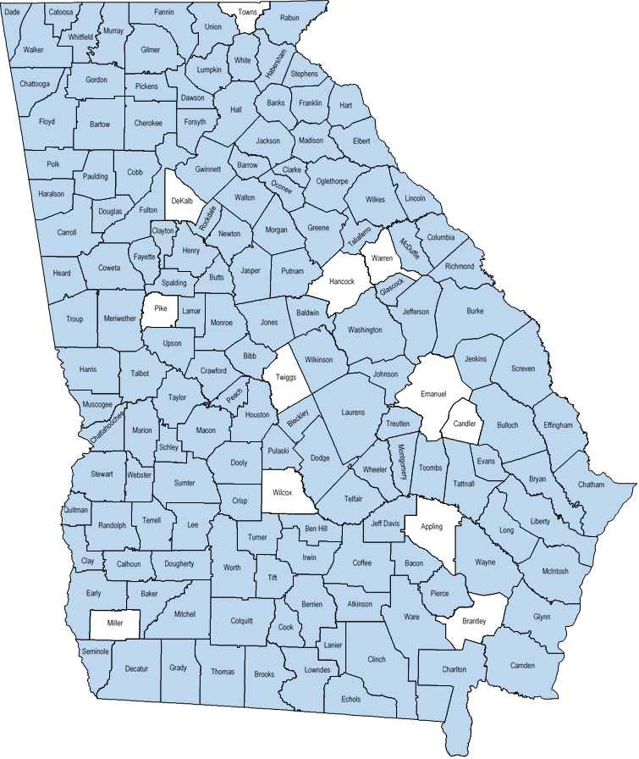
Participating Counties
Responding Counties | Population Range
5 | 250,000+
19 | 100,000-249,999
16 | 50,000-99,999
31 | 25,000-49,999
31 | 15,000-24,999
18 | 10,000-14,999
28 | Less than 10,000
Notes:
The survey’s sample was both geographically diverse and diverse in the populations of counties represented.
Response Rate by Population
Less than 10,000 - 87.5%
10,000 and 14,999 - 90%
15,000 and 24,999 - 88.6%
25,000 and 49,999 - 100%
50,000 and 99,999 - 100%
100,000 and 249,999 - 100%
Greater than 250,000 - 83.3%

Slide 3
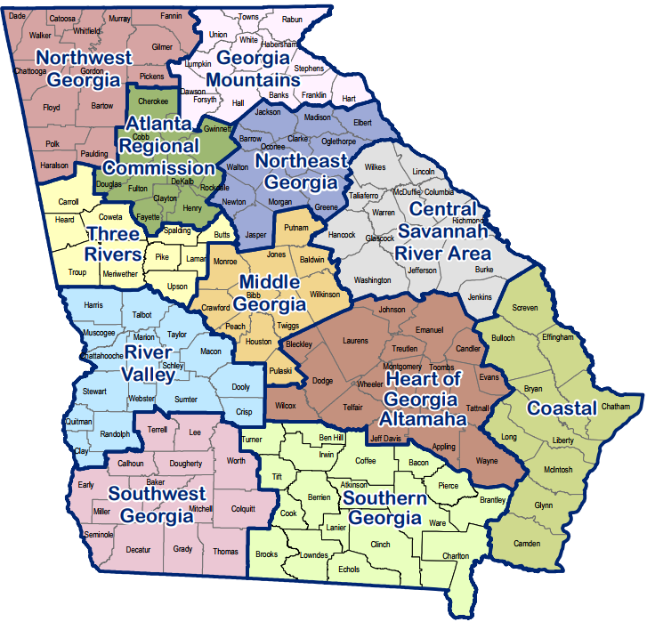
Participating Counties by Region
Regional Commission | Count
Northwest Georgia | 15
Georgia Mountains | 12
Atlanta Regional Commission | 9
Three Rivers | 8
Northeast Georgia | 12
River Valley | 16
Middle Georgia | 10
Central Savannah River Area | 12
Southwest Georgia | 13
Southern Georgia | 17
Heart of Georgia/Altamaha | 13
Coastal | 10
Notes:
Response Rate by Region
Northwest Georgia - 100%
Georgia Mountains - 92.3%
Atlanta Regional Commission - 90%
Three Rivers - 90%
Northeast Georgia - 100%
River Valley - 100%
Middle Georgia - 90.9%
Central Savannah River Area - 92.3%
Southwest Georgia - 92.9%
Southern Georgia - 94.4%
Heart of Georgia/Altamaha - 76.5%
Coastal - 100%

Slide 4
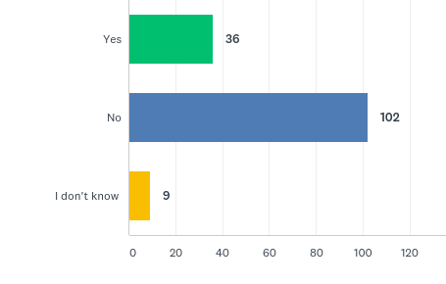
Does your county have a civil service/ merit system?
(A civil service system is generally created by a local ordinance or resolution and provides certain employment protections and processes and may also include compensation requirements. It is not simply a merit increase program or personnel policy enacted by your county).
Notes:
Of the 147 counties that responded to this question, 36 answered “Yes,” 102 answered “No,” and 9 answered “I don’t know.”

Slide 5
Who is included in your county's civil service/merit system?
(In order for Sheriff's staff to participate, the current or previous Sheriff would have to opt into the system.)
Notes:
Of the 36 counties that have a county civil service or merit system and answered this question, 11 counties include only county employees, 6 counties include only sheriff’s office employees, including deputies and jailers, and 19 counties include both.

Slide 6
Number of Deputies
Notes:
141 counties responded to this question and provided the number of deputies.
72.3% of counties that responded to this question have sheriff’s departments that employ less than 50 deputies.
According to the responses received, the average county sheriff’s department employs around 53 deputies.

Slide 7
Number of Jailers
Notes:
141 counties responded to this question and provided the number of jailers.
81.6% of counties that responded to this question have less than 50 jailers employed.
According to the responses received, the average county employs around 38 jailers.

Slide 8
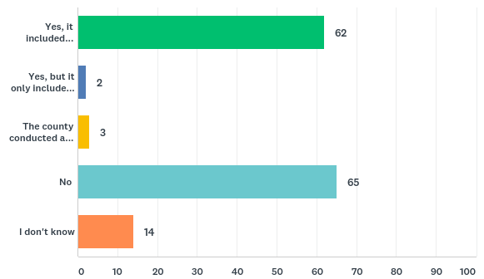
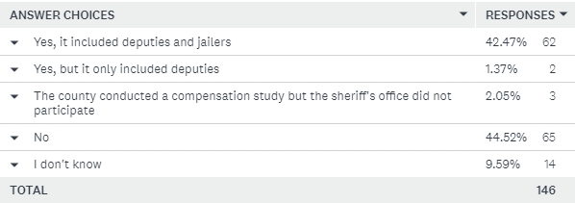
Has your county conducted a compensation study that included Sheriff's office employees (deputies and/or jailers)?
Notes:
Of the 64 counties who conducted a compensation study including sheriff’s office employees, 39 were conducted within the last 5 years, with 31 being conducted within the last 2 years. Additionally, 13 of the counties completed a compensation study longer than 5 years ago and 12 counties did not indicate when their compensation study was conducted.
Overall, the vast majority of counties have conducted their compensation studies recently.

Slide 9
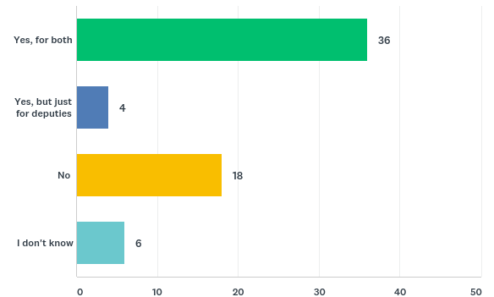
Based on the outcome of this study, did your county increase compensation for Sheriff's office employees (deputies and/or jailers) ?
Notes:
Of the 64 counties who conducted a compensation study, 36 increased compensation for both deputies and jailers, 4 increased compensation only for deputies, 18 did not increase compensation for deputies or jailers, and 6 respondents did not know the answer to the question.

Slide 10
Was it an across the board increase or was it position based?
Notes:
As a result of their compensation studies, 28 counties offered position based increases, 7 counties offered position based increases, 4 counties offered increases in other ways, 2 counties were still doing their compensation studies but anticipated providing increases, and 2 counties were unaware of how they provided increases.

Slide 11
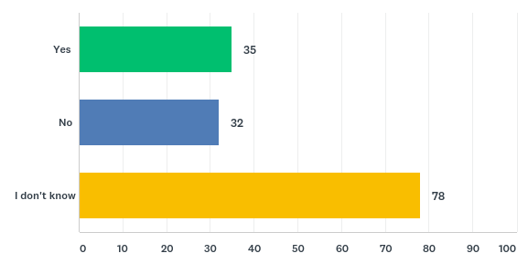
Does your county plan on conducting a compensation study within the next three years that would include Sheriff's office employees?
Notes:
In response to this question, 35 counties indicated that they plan to conduct an upcoming compensation study, 32 counties indicated that they did not plan to conduct an upcoming compensation study, and 78 respondents did not know whether their county was planning an upcoming compensation study.
Of the 32 counties that indicated that they do not plan on conducting a compensation study, 8 completed such a study within the last 5 years.

Slide 12
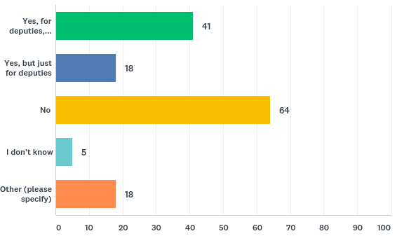
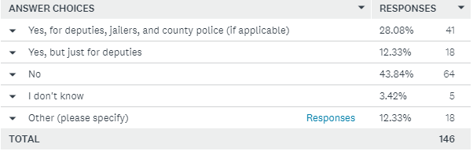
Has your county provided a salary increase (outside the recommendation of a compensation study) solely for law enforcement in your county within the last three years?
Notes:
Several counties indicated in the Other category that the sheriff was giving raises as he saw fit.
Additionally, a couple of counties indicated that position based raises were given to deputies in their departments due to reclassification.
Finally, just because the answer to this question is no does not mean that deputies and/or jailers did not get a raise. Instead, they may have just received a raise as part of a compensation study.

Slide 13
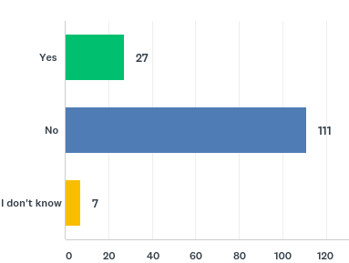
Has your Sheriff received any salary increases beyond the annual mandated COLA and longevity increases required under state law?
Notes:
Of the 145 counties that answered this question, 27 indicated that their sheriff’s salary had increased outside of COLA and longevity increases, 111 counties indicated that their sheriff’s salary did not, and 7 respondents did not know the answer to this question.

Slide 14
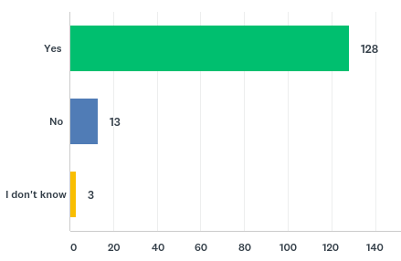
Does your county generally provide COLA's or merit increase to the Sheriff's deputies and jailers when county employees receive them?
Notes:
According to our survey, sheriff’s deputies and jailers receive COLA or merit increase raises 88.9% of the time that county employees receive them, suggesting that sheriff’s deputies and jailers are being treated comparably to other county employees.

Slide 15
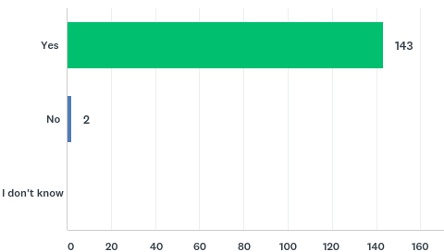
Does your county provide health insurance for Sheriff's deputies and jailers?
Notes:
Of the 143 counties that answered this question, only 2 counties do not provide health insurance for sheriff’s deputies and jailers.

Slide 16
What percentage cost does the county cover for individual/single health plans?
% Health Insurance Cost Paid by County
Percentage | Frequency
Less than 50% | 3
50%-60% | 1
60%-70% | 8
70%-80% | 20
80%-90% | 37
90%-100% | 52
Notes:
89.3% of the respondents to this question provide 70% or more of the cost for individual/single health plans.

Slide 17
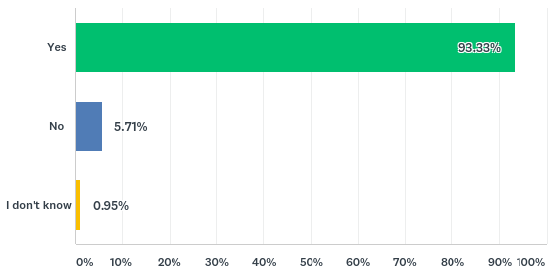
Does your county provide health insurance for the families of Sheriff's deputies and jailers?
Notes:
Of the 105 counties that answered this question, only 6 counties do not provide health insurance for the families of sheriff’s deputies and jailers.

Slide 18
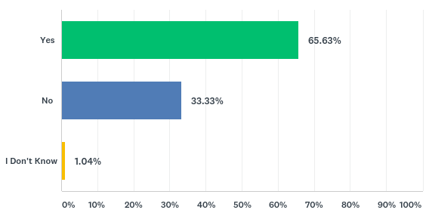
Does your county contribute a % towards the health insurance of families of sheriff’s deputies and jailers?
Notes:
Of the 96 counties that answered this question, 63 contribute to the cost of the health insurance for the families of sheriff’s deputies and jailers while 32 do not.
The average county that contributes provides for 76.4% of the cost of health insurance for the families of sheriff’s deputies and jailers.

Slide 19
Other Insurance Offered
Notes:
104 counties offer vision insurance but do not contribute while 15 counties fully contribute.
80 counties offer dental insurance but do not contribute while 20 counties fully contribute.
55 counties offer accidental death and dismemberment insurance but do not contribute and 64 counties fully contribute.
112 counties offer short term disability insurance and do not contribute and 13 counties fully contribute.
86 counties offer long term disability insurance and do not contribute and 31 counties fully contribute.
106 counties offer hospital indemnity insurance and do not contribute and 1 county fully contributes.
19 counties offer life insurance and do not contribute while 103 counties fully contribute.
The sample of county police departments was very small, as there are only 14 county police departments in Georgia. However, Sheriff’s departments and county police departments largely offer comparable benefits, paying a similar percentage towards retirement and health insurance and offering similar benefits.
For example, Dougherty County pays for 82% of their employees’ health insurance for both sheriff’s deputies and jailers and county police officers. Similarly, they pay the same towards retirement for both groups. Glynn County does the same, paying the same percentage towards health insurance and retirement for both groups, something that replicates itself across other counties.

Slide 20
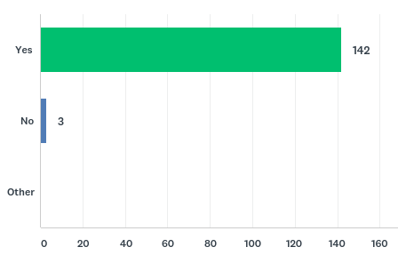
Does your county offer retirement plans to Sheriff's deputies and jailers?
Notes:
Out of the 133 respondents, only three counties do not offer a retirement plan to Sheriff’s deputies and jailers.

Slide 21
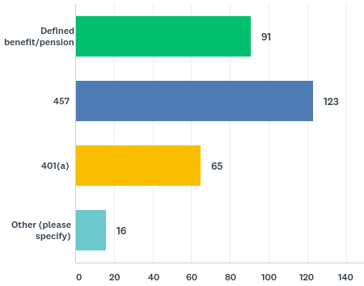
What type of retirement plans are offered to Sheriff's deputies and jailers?
Notes:
This was a Select all that apply question.
Some of the counties that responded “other” indicated that the county offered POAB to their officers. Other counties indicated that they had 401(k) and 401(h) plans, among other varied retirement plans.

Slide 22
What is the maximum percentage that the employer contributes towards the retirement plan per employee?
For 9 counties, retirement is funded entirely by the individual employee.
For 20 counties, the County funds 100% of an employee’s Defined Benefit Retirement Plan.
However, for 101 counties, both the employee and County are contributing to an employee’s retirement plan.

Slide 23
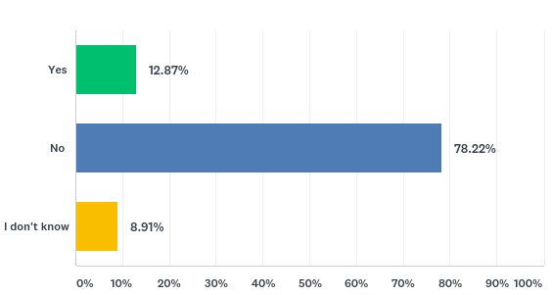
Does your county pay for the Peace Officers Annuity and Benefit (POAB) Fund dues for your sheriff’s deputies?
Notes:
Only 13 counties contribute to the POAB dues of their officers.
10 counties pay 100% of the cost.
1 county pays for 50% of the cost.
2 counties contribute but are not sure what %.

Slide 24
Employee Benefits for Deputies and Jailers
Notes:
This was a select all that apply question.
Several counties offer unique benefits. Examples provided under “other” include pay differentials for higher education degrees, employee assistance programs, wellness programs, extra training, and additional firearms.

Slide 25
Are there any types of benefits provided to deputies that are not also provided to jailers?
Notes:
There is largely no difference in benefits between those given to deputies and those given to Sheriff’s deputies. The only differences indicated were that some counties pay for POAB take home cars for their sheriff’s deputies. Jailers are not able to participate in POAB.

Slide 26
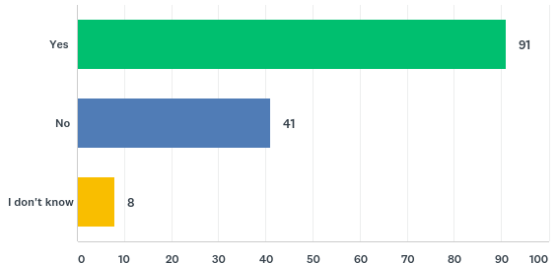
Does the Sheriff participate in any of your county's retirement plans?
Notes:
Around 65% of all sheriff’s participate in their county’s retirement plans.

Slide 27
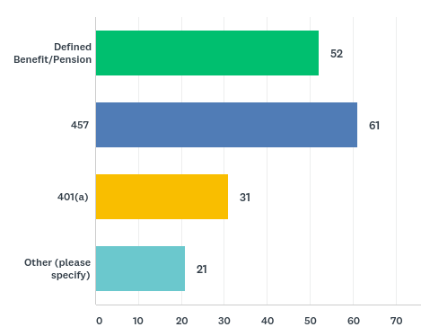
In which retirement plan(s) does the Sheriff participate?
Notes:
This was a select all that apply question.
Five sheriffs voluntarily choose to use the POAB Retirement program, but they have choices among other retirement plans offered by their respective counties.
Three counties indicated that their sheriff opted not to use a retirement plan, but in these cases, they were offered to the sheriff.
Six counties indicated that their sheriffs were using a retirement plan offered by the Sheriff’s Retirement Fund of Georgia.

Slide 28
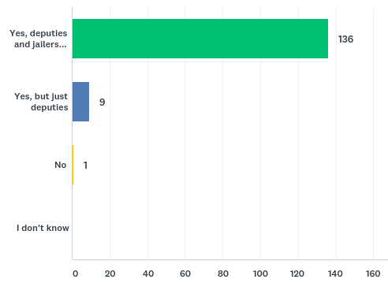
Do Sheriff's deputies or jailers receive paid sick leave, annual leave, or PTO (paid time off)?
Notes:
The majority of counties offer their deputies and jailers at least 80 hours of sick leave per year.
Annual leave varies greatly from county to county and is largely based on longevity, but deputies and jailers do overwhelmingly receive paid time off.

Slide 29
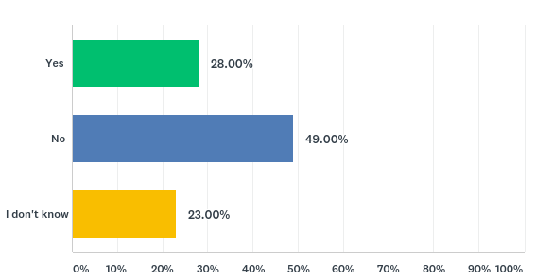
Do sheriff’s deputies and jailers have a higher attrition rate in your county than other county employees?
Notes:
Of 100 respondents, 49 indicated that their sheriff’s deputies and jailers do not have a higher attrition rate in their county than do other county employees.

Slide 30
Conclusion
The results of the survey indicate that counties are providing a variety of benefits to local law enforcement and that there is generally parity in compensation and benefits between county jailers, sheriff’s deputies, county law enforcement officers, and other county employees.

Slide 31
Contact Information
Thank you for your time and consideration, if you have questions or need additional information please contact:
Debra Nesbit, dnesbit@accg.org,
Phone (404) 522-5022
Cell (404) 617-4755

