Slide 1
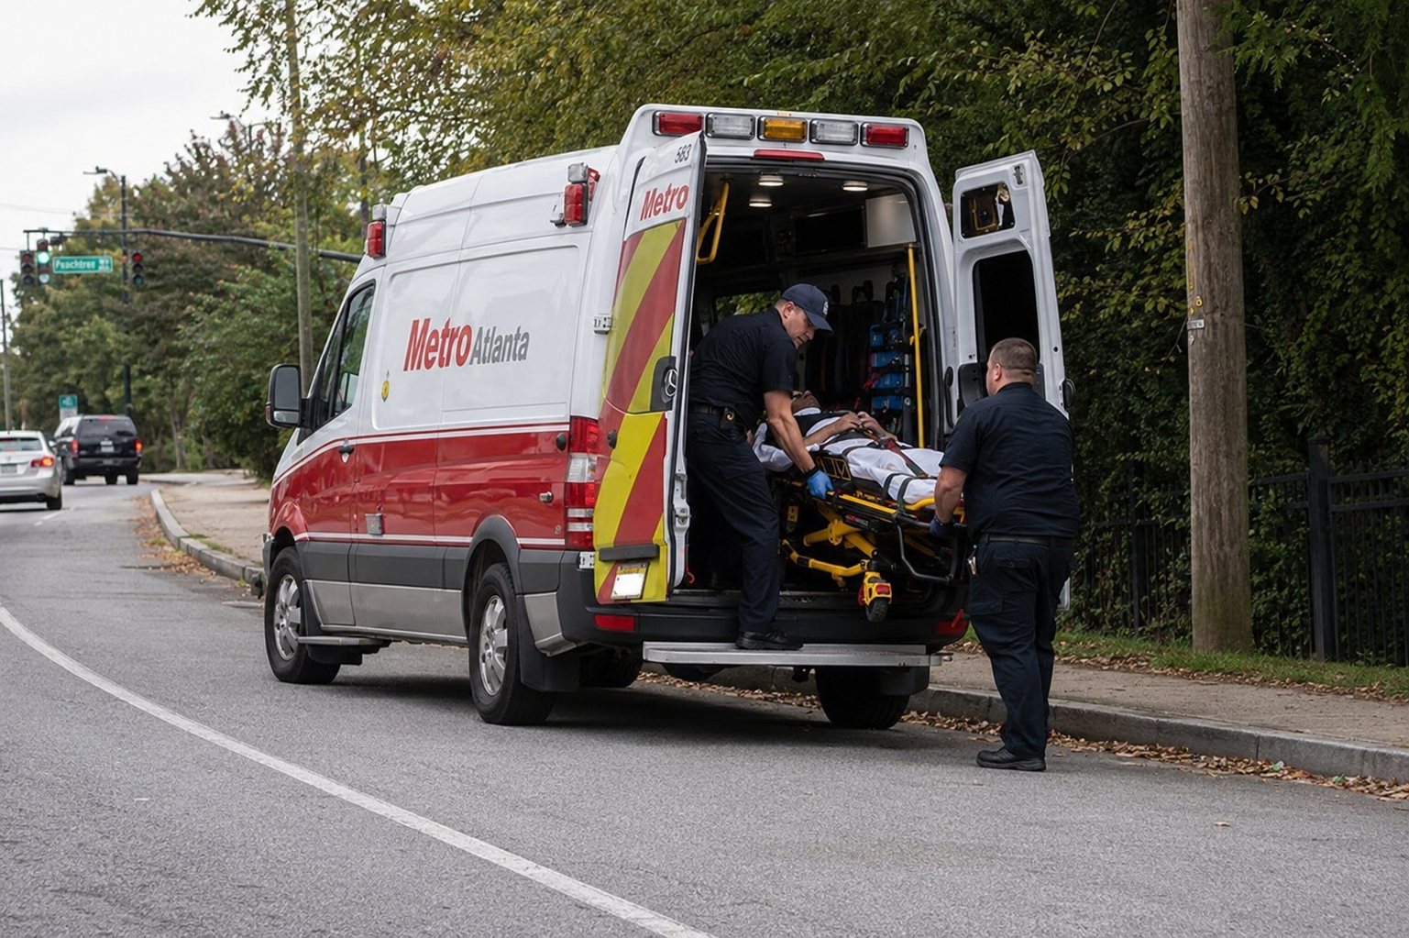
EMS Readiness, Preparedness
& Workforce Sustainability
Prepared for the Blue-Ribbon-House Study Committee on EMS
August 12 • Augusta, Georgia
Georgia EMS Association (GEMSA)
Georgia Ambulance Providers Association (GAPA)
Presented by Chad Black and Terence Ramotar
Notes:
Opening: frame EMS as both healthcare access and public safety readiness. State that this is a policy conversation focused on sustainable funding, workforce stability, and practical accountability.

Slide 2
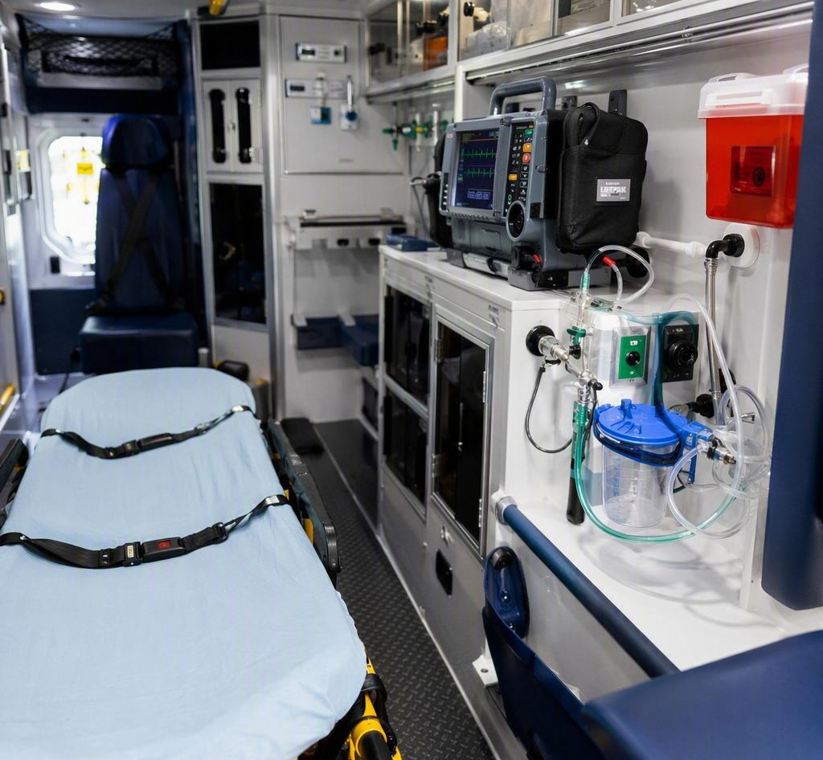
BLUE RIBBON HOUSE STUDY COMMITTEE ON EMS
EMS is Georgia’s front line of healthcare
A strong healthcare system requires a strong EMS system.
•
Available in every community: rural, suburban and urban.
•
Responds regardless of income, insurance status, location or ability to pay.
•
Often the first — and sometimes only — healthcare professional on scene.
•
Provides clinical assessment, stabilization, treatment and transport decisions under medical oversight.
Policy point
EMS is expected to be ready 24/7, yet reimbursement is still tied primarily to transport.
Not simply transportation — care comes directly to the patient.
Sources: GEMSA/GAPA draft slides; BLS Occupational Outlook Handbook; AMA Journal of Ethics.
Georgia EMS Association (GEMSA) + Georgia Ambulance Providers Association (GAPA) • August 12 • Augusta, Georgia
Notes:
This is the “why it matters” slide. Move quickly from EMS as front door to the policy issue: readiness is required before the call, but the payment system mostly recognizes transports after the call.

Slide 3
BLUE RIBBON HOUSE STUDY COMMITTEE ON EMS
Estimated annual cost to keep one ALS ambulance ready 24/7 in Georgia
A realistic planning estimate for one fully staffed Advanced Life Support ambulance available 24 hours a day, 365 days a year.
$1.2M
Estimated annual cost components
Annual estimate
Paramedic and EMT/AEMT staffing
$500,000–$600,000
reasonable annual midpoint
Benefits, payroll taxes, leave and overtime coverage
$200,000–$275,000
Ambulance replacement / depreciation
$60,000–$90,000
Gross operating and readiness cost
"Before" billing revenue is collected
Cardiac monitor, stretcher and medical equipment
$30,000–$50,000
Fuel, maintenance, tires and vehicle insurance
$70,000–$110,000
Medications, oxygen and disposable supplies
$40,000–$80,000
$1.03M
$1.44M
Medical direction, training and quality assurance
$30,000–$60,000
low estimate
high estimate
Dispatch, supervision, billing, IT and admin support
$100,000–$175,000
Estimated annual total
$1.03 million to $1.44 million
$137
approx. cost per staffed unit-hour
Policy point
This readiness cost exists before the first 911 call is answered and whether or not a patient is transported.
Sources: Georgia wage benchmarks (Indeed, accessed July 2026); Georgia EMS rules requiring 24/7 zone coverage and licensed staffing; MedPAC ambulance cost analysis; planning estimate synthesized for GEMSA/GAPA.

Slide 4
BLUE RIBBON HOUSE STUDY COMMITTEE ON EMS
The core workforce problem: short career lifespan
Frontline pre-hospital providers are leaving the field almost as fast as they enter it.
3–5
5–7
36%
27%
1 in 3+
EMT years
planning range
Paramedic years
planning range
Full-time EMT
turnover
Full-time paramedic
turnover
New hires leave
in year one
At this rate, EMS is not simply losing employees—we are losing experience, institutional knowledge, and future leaders, and we must reverse this trend as it continues to compromise the readiness and reliability of the emergency response system our communities depend on.
Every 3–4 years
EMS agencies experience complete workforce turnover, according to the AAA/Newton 360 turnover study.
Sources: AAA/Newton 360 EMS Industry Turnover Study, 2022; AMA Journal of Ethics, 2022; JEMS citing Leonard Davis Institute, 2017.
Georgia EMS Association (GEMSA) + Georgia Ambulance Providers Association (GAPA) • August 12 • Augusta, Georgia
Notes:
When presenting: state that 3–5 and 5–7 years are planning ranges/field estimates, while AAA/Newton 360 data is the strongest national benchmark: 36% full-time EMT turnover, 27% full-time paramedic turnover, full turnover every 3–4 years, and more than one-third of new hires leave in year one.

Slide 5

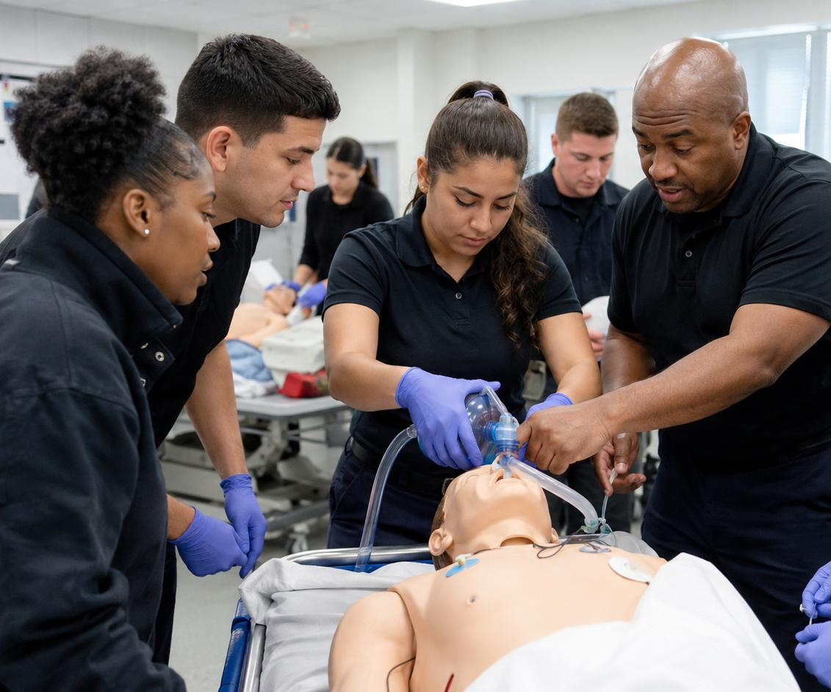

BLUE RIBBON HOUSE STUDY COMMITTEE ON EMS
The workforce crisis is statewide
The challenges look different by geography — some and many overlap, but the result is the same: fewer staffed ambulances and less community readiness.
Urban systems
Suburban / growth counties
Rural communities
•
High call volume
•
Rapid demand growth
•
Smaller applicant pools-Competition for staff
•
Hospital offload delays
•
Traffic & turnaround time
•
Longer transports
•
Burnout & overtime
•
Expansion pressure
•
Limited tax base
•
Competition for staff
•
Competition for staff
•
Fewer hospitals nearby
Same policy failures — different consequences. Funding and workforce solutions must work for every EMS model.
Source: GEMSA/GAPA draft slides and stakeholder input.
Georgia EMS Association (GEMSA) + Georgia Ambulance Providers Association (GAPA) • August 12 • Augusta, Georgia
Notes:
This slide keeps the coalition unified. Do not let urban/rural dynamics divide the message: the root causes are the same, although symptoms differ.

Slide 6
BLUE RIBBON HOUSE STUDY COMMITTEE ON EMS
Rural Health Transformation: a major EMS pipeline opportunity
Five-year earn-while-you-learn program designed to remove education and salary barriers while building rural EMS capacity.
1,350
1,000
350
~1,013
total new EMS professionals
new EMTs
new paramedics
projected graduates at 75% completion
Policy value
•
Covers educational expenses and part of salary during training.
•
Graduates serve 5 years in one of Georgia’s rural counties.
•
Success requires tracking completion, licensure, placement and post-commitment retention.
Source: GEMSA/GAPA draft Rural Health Transformation workforce proposal.
Georgia EMS Association (GEMSA) + Georgia Ambulance Providers Association (GAPA) • August 12 • Augusta, Georgia
Notes:
Support the program fully, but make the retention point: training alone will not stabilize EMS if graduates leave after the commitment or if experienced field clinicians continue to exit.

Slide 7

BLUE RIBBON HOUSE STUDY COMMITTEE ON EMS
Recruitment only works if retention improves
We cannot educate our way out of the problem if experienced EMTs and paramedics keep leaving faster than we replace them.
Recruit
Train
Complete
Employ
Retain
Biggest leak: experienced field clinicians
Hospitals and clinics recruit paramedics because they are clinically valuable — often with higher pay, more predictable schedules, and less field risk.
Sources: BLS 2024 wage data; AMA Journal of Ethics, 2022; GEMSA/GAPA draft slides.
Georgia EMS Association (GEMSA) + Georgia Ambulance Providers Association (GAPA) • August 12 • Augusta, Georgia
Notes:
Key line: the goal is not to limit paramedics from advancing; the goal is to fund EMS so the ambulance remains a competitive career choice. BLS 2024: EMT median annual wage $41,340; paramedic $58,410.

Slide 8
BLUE RIBBON HOUSE STUDY COMMITTEE ON EMS
The cost before the call: readiness and preparedness
EMS is expected to be ready whether a transport happens or not.
Staffed ambulances
Equipment & medications
24/7/365
Wages, benefits, overtime and supervisory coverage
Monitors, stretchers, drugs, PPE and replacement cycles
readiness
Medical direction & oversight
Deployment & communications
Protocols, quality improvement, training and compliance
Coverage plans, CAD/radio systems and geographic readiness
Lower call volume does not mean lower readiness cost.
Source: GEMSA/GAPA draft slides; cost categories reflect common EMS operating requirements.
Georgia EMS Association (GEMSA) + Georgia Ambulance Providers Association (GAPA) • August 12 • Augusta, Georgia
Notes:
Tie readiness to workforce: if readiness is not funded, agencies cannot staff ambulances, maintain equipment, train personnel, or support clinical oversight.

Slide 9
BLUE RIBBON HOUSE STUDY COMMITTEE ON EMS
Reimbursement is a workforce issue
When reimbursement fails to cover the true cost of service, workforce stability weakens.
Operational impact
•
Delayed wage increases
•
Vacant positions
•
Reduced benefits
•
Mandatory overtime
•
Equipment replacement delays
•
Ambulances out of service
Policy priority: improve Medicaid, support appropriate Medicare reforms, require fair commercial insurance payment and direct payment to EMS.
Source: Funding the Front Line draft deck; example cost/payment figures shown for policy illustration.
Georgia EMS Association (GEMSA) + Georgia Ambulance Providers Association (GAPA) • August 12 • Augusta, Georgia
Notes:
Say explicitly that this is Terence’s section to detail Medicare, Medicaid and commercial insurance. Your bridge is that reimbursement is the engine that determines workforce sustainability.

Slide 10
BLUE RIBBON HOUSE STUDY COMMITTEE ON EMS
Modern reimbursement: protect patients and fund the response
Emergency ambulance care is a covered health insurance benefit — but EMS cannot choose its patients, payer, network status or emergency location.
1
Protect patients
2
Set a minimum standard
3
Pay EMS directly
Remove the patient from the middle and prevent surprise balance billing for emergency transports accomplished in 2025 Georgia Legislature.
Require insurers to reimburse out-of-network emergency ambulance service at a fair, predictable level.
Ensure payment goes to the provider that responded, staffed the unit and delivered care.
The goal is not to shift cost to taxpayers. It is to put responsibility back on the insurer that accepted the premium for emergency coverage.
Source: Funding the Front Line draft deck; commercial reimbursement policy models commonly use local contracted rates, Medicare multipliers, and billed-charge caps.
Georgia EMS Association (GEMSA) + Georgia Ambulance Providers Association (GAPA) • August 12 • Augusta, Georgia
Notes:
This slide gives Terence a clear landing pad. Keep it simple: patient protection + insurer accountability + direct payment to EMS.

Slide 11

BLUE RIBBON HOUSE STUDY COMMITTEE ON EMS
Hospital offload delays remove ambulances from the system
A crew waiting at the hospital is on duty — but functionally unavailable for the next 911 call.
•
Units not available for critical emergencies.
•
Response-time pressure increases across the system.
•
Crews experience frustration, fatigue and overtime.
•
Additional units are needed just to maintain coverage.
•
Reducing delays can return workforce hours without hiring new personnel.
EMS and Hospitals must be partners in protecting ambulance availability.
Source: GEMSA/GAPA draft slides; hospital offload and transfer-delay discussion.
Georgia EMS Association (GEMSA) + Georgia Ambulance Providers Association (GAPA) • August 12 • Augusta, Georgia
Notes:
This is a readiness issue, not just a hospital throughput issue. Every wall-time hour is a paid EMS hour that cannot be used to answer the next call.

Slide 12
GEORGIA SYSTEMS OF CARE
Coordinated Care. Connected Systems. Better Outcomes
A STATEWIDE IMPACT
 | 187 DESIGNATED FACILITIES across Georgia
 | HOSPITALS AND EMS agencies working together
 | THOUSANDS of Georgians saved every year
 | BETTER OUTCOMES
WHAT WE DO
CARDIAC | Emergency Cardiac Care Center Designation, STEMI systems, Cardiac Registry, Data Reporting
TRAUMA | Trauma Center Designation, EMS/Hospital alignment, EMS and Hospital Quality Improvement
STROKE | Stroke Center Designation, Statewide Coordination, EMS and Hospital Quality Improvement
PEDIATRIC EMS | EMS-C Systems Development, Pediatric Readiness, Education and Coordination
SYSTEM COORDINATION | EMS ↔ Hospitals ↔ Specialty Centers ↔ Public Health and Partners
WHY IT MATTERS
Heart attack and cardiac arrest outcomes depend on minutes
Coordinated trauma systems reduce preventable death and disability
Rapid recognition, transport, and reperfusion can prevent lifelong disability
Children require specialized resources that aren't available everywhere
A designation alone doesn't save lives. The system around the designation does
    BOTTOM LINE: We don’t just designated hospitals.
    We build the systems that connect EMS, hospitals, specialty care, data, and quality improvement into a statewide continuum.

Slide 13
WHAT GEORGIA SYSTEMS OF CARE NEEDS
To Keep Moving The Needle And Save More Lives
SUSTAINABLE FUNDING
DATA AND ANALYTICS
RURAL & REGIONAL SYSTEM DEVELOPMENT
  Dedicated and predictable annual funding
  Grant opportunities to help Hospital and EMS implement system improvements
  Upgrades and enhancements to statewide registries
  Fully funded Epidemiologists
  Strengthen rural coordination and referral pathways
  Ensure ALL Georgians have access to specialty care centers
GEORGIA HAS BUILT THE FOUNDATION.
NOW WE NEED THE CAPACITY TO SUSTAIN IT, MEASURE IT, AND TAKE IT FURTHER

Slide 14


Slide 15
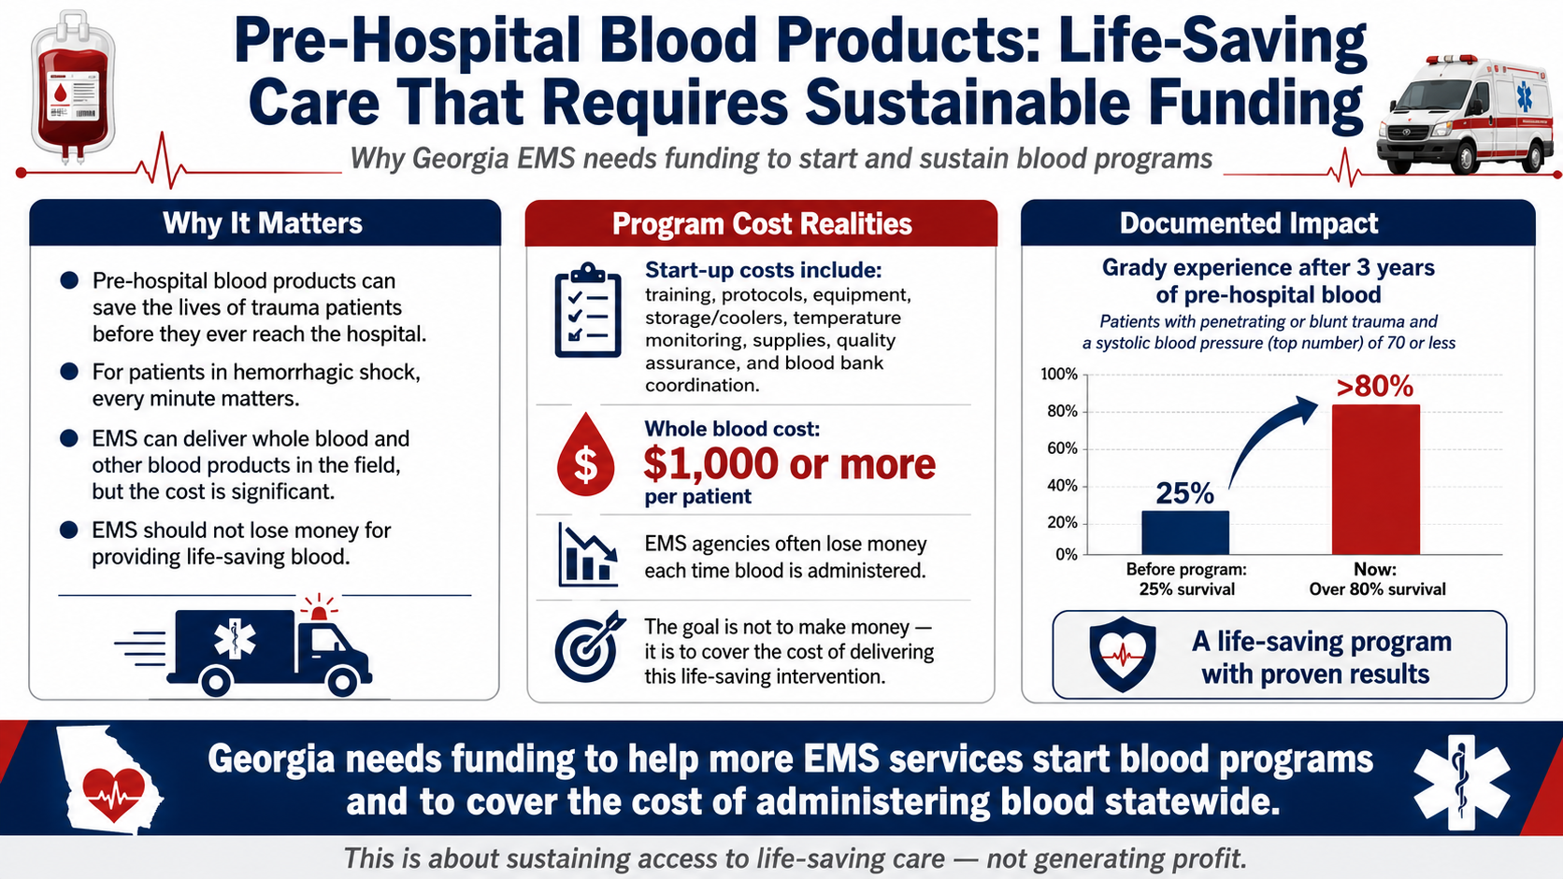
Source note: Published cost estimates vary by program and product; examples include ~$925 per patient and $500–$1,000+ per transfusion. Costs are generally not separately reimbursed under current ambulance payment structures.
Notes:
Use this as the clinical proof point. Prehospital blood is one of the most important lifesaving EMS innovations in decades, but it creates new costs: training, protocols, storage, temperature monitoring, QA, blood bank coordination and product cost. Ask the committee to cover the cost of delivering the intervention, not to generate profit.

Slide 16
Action Agenda for a Sustainable EMS System
When someone calls 911, the question is not whether an ambulance exists. The question is whether it is staffed, equipped, funded and ready to respond, and available to respond!
•
Fully support the Rural Health Transformation EMS workforce programs and plan for sustainability after the initial 5-year grant.
•
Create a permanent statewide EMS workforce and readiness funding mechanism.
•
Improve Medicaid and commercial reimbursement, including direct payment to EMS.
•
Fund readiness and preparedness — not just transportation.
•
Create funding sources to implement and sustain pre-hospital blood administration.
•
Support retention, compensation, benefits, leadership development and career ladders.
•
Address hospital offload delays and unnecessary loss of ambulance hours.
Chad Black • GEMSA Chairman of the Board
Terence Ramotar • GAPA Chairman
Thank you — on behalf of GEMSA and GAPA
Notes:
Close with a clear ask: EMS does not need temporary relief only. Georgia needs a sustainable structure that funds readiness, stabilizes the workforce, modernizes reimbursement and supports lifesaving innovation.

Slide 17
Thank You
Georgia EMS Association (GEMSA) • Georgia Ambulance Providers Association (GAPA)
Chad Black
Terence Ramotar
GEMSA
GAPA
770-530-4365
786-574-1202
House Blue Ribbon Study Committee on EMS • Augusta, Georgia • August 12

