Slide 1
BLUE-RIBBON STUDY COMMITTEE ON LOCAL GOVERNMENT TAXATION, FUNDING, AND BUDGETING
Local Franchise Fees
in Georgia
Who has the legal authority to collect them — and who doesn't
ACCG — Association County Commissioners of Georgia

Slide 2
PART I
What Is a Franchise Fee?
Electric
Cable
A franchise fee is compensation a municipal government charges a utility for the right to use public streets and rights-of-way.
LARGEST CATEGORY
Natural Gas
Water
Franchise fees apply across several utility categories — electric is by far the largest, and the focus of this presentation.
Sanitation
Telephone
Definition & purpose
Local Franchise Fees in Georgia

Slide 3
PART I
A Brief History
100+ yrs
1976
Ongoing
Today
City Charter Authority
State Law Codifies It — For Cities
Reinforced Elsewhere in Law
A Home Rule Limitation
Municipal franchise fees existed in Georgia for over a century under individual city charters.
The General Assembly codified franchise fee authority in O.C.G.A. § 36-34-2(7). No comparable statute was enacted for counties.
The Georgia Electric Territorial Services Act (O.C.G.A. § 46-3-14) again recognizes only a municipality's right to grant an electric franchise.
Counties cannot create this authority on their own. State law already grants it to cities, not counties — only the General Assembly can change that.
Local Franchise Fees in Georgia

Slide 4
PART II
Georgia's Electric Landscape
Georgia's electric utilities fall into three groups. Only one is regulated in a way that makes the franchise-fee mechanics visible.
EMCs
MEAG Cities
Georgia Power
41 Electric Membership Corporations
~49 Municipally-Owned Utilities
Investor-Owned Utility
Member-owned cooperatives
Operate outside PSC regulation
Separate governance structure
Owned & governed by cities
Operate outside PSC regulation
Separate governance structure
Regulated by the PSC
Franchise fees recovered via approved tariff
Foundational order: Docket 21112-U (2007)
THE FOCUS OF THIS DISPARITY
EMCs and MEAG operate outside PSC regulation
Local Franchise Fees in Georgia

Slide 5
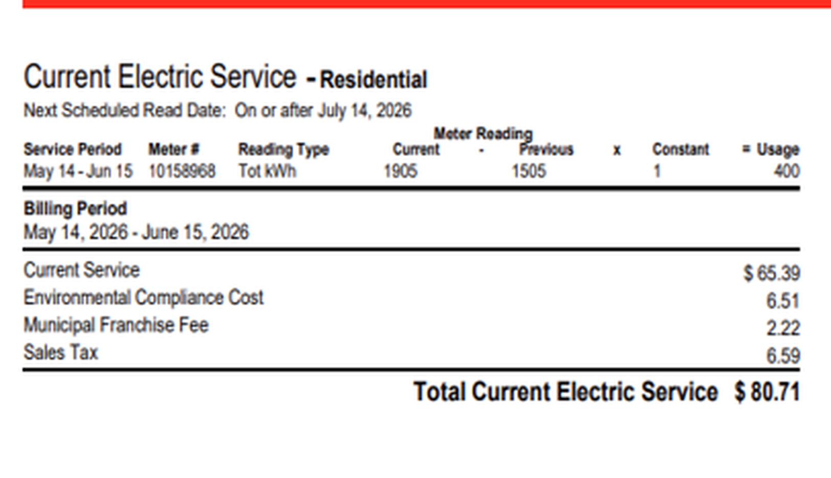
PART II
Where the Disparity Is Sharpest
1.1995%
Outside-city franchise fee rate — still 100% remitted to the city, not the county. (Inside-city rate: 3.0843%.)
$3B
of Georgia Power's 2025 retail revenue is projected to come from customers outside city limits
37%
share of the fee collected from unincorporated customers — all of which still flows to cities
↑ Municipal Franchise Fee — $2.22, charged on every bill, inside or outside city limits.
Outside the city, the county receives none of it.
Actual Georgia Power residential bill; MFF-11 Tariff, PSC Docket No. 44280
Local Franchise Fees in Georgia

Slide 6
PART III
The Numbers: Cities vs. Counties
STEP 1 — 2024 TOTAL FRANCHISE FEES, ALL CATEGORIES (Source: RLGF, Georgia DCA / UGA Carl Vinson Institute)
Cities
$314.6M
~3-to-1
Counties
$109.2M
STEP 2 — REMOVE CONSOLIDATED GOVERNMENTS (–$69M — collected under municipal charter authority, though reported as counties)
Cities
$314.6M
~8-to-1
Standalone
Counties
$40.2M
STEP 3 — NARROW TO ELECTRIC FRANCHISE FEES ONLY
Cities
$247.8M
~147-to-1
Standalone
Counties
$1.69M
STEP 4 — REMOVE CRISP COUNTY (–$1.41M — its own municipally-owned electric utility, a unique constitutional carve-out)
Cities
~$250M
Functionally $0
Remaining
Counties
$0.28M
RLGF FY2024, Georgia DCA / UGA Carl Vinson Institute
Local Franchise Fees in Georgia

Slide 7
BOTTOM LINE
Cities can collect this revenue.
Counties can't.
Georgia's electric landscape is changing quickly. The customers coming to our state — and the counties hosting them — deserve a legal framework that reflects the world as it is, not the one it was in 1976.
Thank you.

